Slide 1
An Introduction to, and a Brief Overview of Reinforcement Learning
By Vikhyath Venkatraman

Slide 2
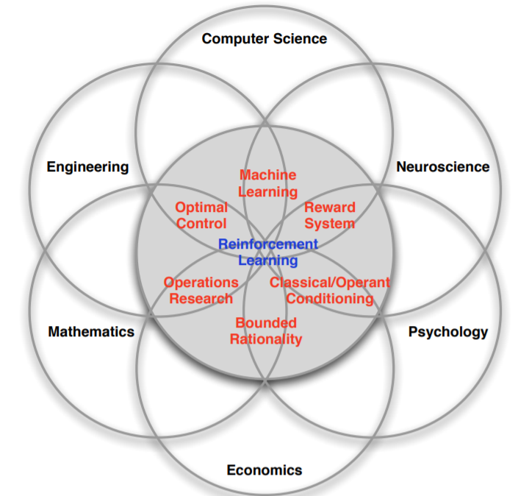
RL is a form of Semi-Supervised learning.
Uses of RL(Explanation)
Used to beat the champions at games like AlphaGo, Atari games etc.
Main use case is when rewards are delayed(eg: robot cleaning a room)
It may be better to sacrifice immediate reward to gain more long-term reward.
Notes:
You may have heard of supervised learning methods(eg:Regression, Classification, Naive Bayes, SVMs, Random Forest etc. These methods rely on labelled input and output data.
You have also probably heard of unsupervised learning methods(eg:k-Nearest Neighbours(k-NN), Principal Component Analysis(PCA), Singular Value Decomposition(SVD), k-Means Clustering etc.). These are used to identify structure in data.
RL is semi-supervised learning, which combines the “best” of both worlds. It mainly removes the labelling of data, as it is time-consuming, and replaces it with a reward. There is no supervisor, only a reward signal.
Reinforcement learning is based on the reward hypothesis. All goals can be described by the maximisation of expected cumulative reward.

Slide 3
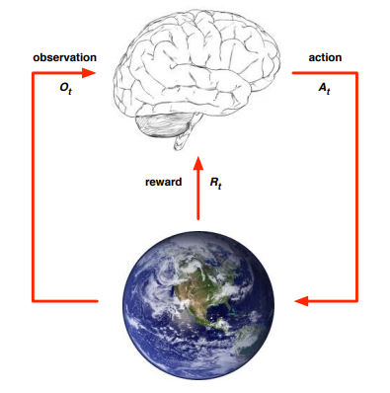
Notes:
Classical Diagram of RL
You take an action. You get a reward, and the next state(which may or may not be the same as the expected state). You act on the basis of that observation to take the next action.

Slide 4
RL Terms
State
Reward
Policy
Model [p(s’ | a, s)]
State Value Function a.k.a Value Function
Action Value Function
Discount Factor(γ)
Notes:
State is the information used to determine what happens next. Formally, state is a function of the history.
Reward r(s, a) is defined as the reward collected by taking the action a at state s.
Policy π(s) is defined as a mapping from states to actions i.e. given a state, what is the action that an agent should take. May be deterministic or stochastic. Deterministic policies still may not end up where we want them to due to the inherent stochasticity of the environment.
Model defines the dynamic of the environment.
Value Function is the amount of expected reward following a particular policy.
Action Value Function is the amount of expected reward obtained by taking an action from a state s, and then following the policy thereon.

Slide 5
More RL Terms
Model Based RL vs Model Free RL
Value Based
Policy Based
Actor Critic
Notes:
Model Based uses DP, MC methods.
Model Free like Q learning, SARSA.
Value based updates the value function. The policy is then updated on the basis of that.
Policy based directly updates the policy.
Actor Critic combines both.

Slide 6
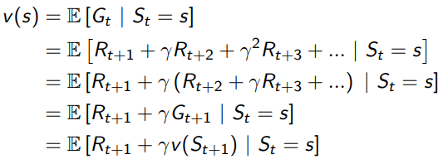
Markov Processes
Markov Process
Markov Reward Process<S,P, R, γ>, Bellman Equation for MRP
Markov Decision Process<S, A,P, R, γ>,
Notes:
A State is Markov, if “The future is independent of the past given the present”. P [St+1 | St ] = P [St+1 | S1, ..., St ]
An MRP is a Markov Process with Values. P is the state transition probability matrix.
Bellman Equation for MRPs give the value function.

Slide 7
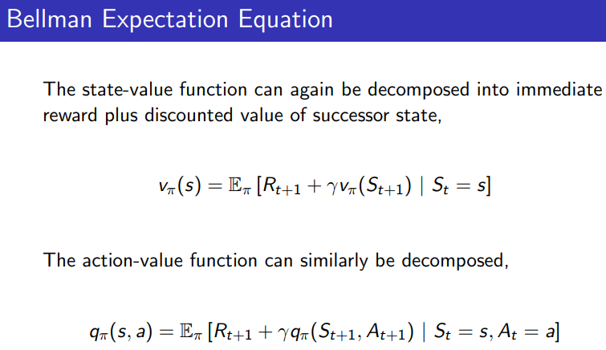

Slide 8
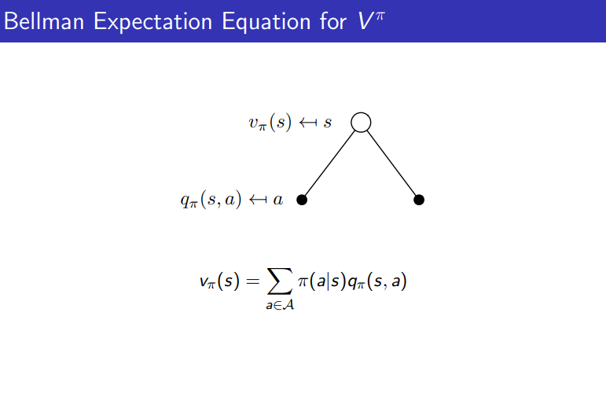

Slide 9
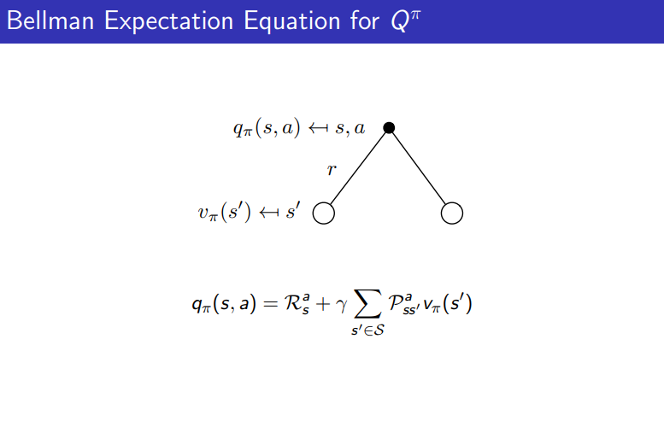

Slide 10
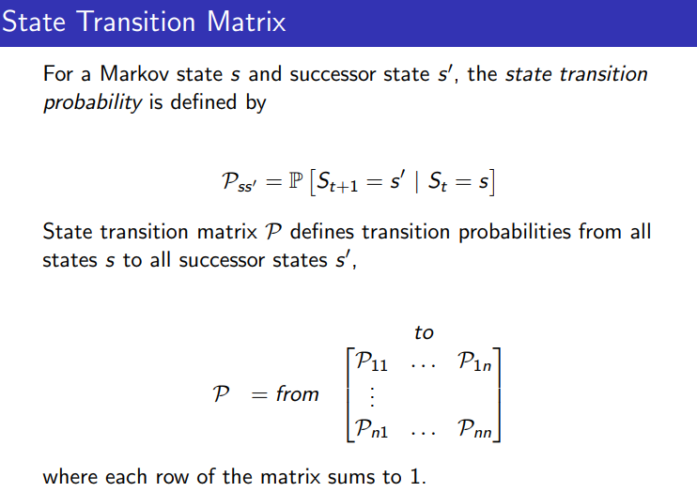

Slide 11
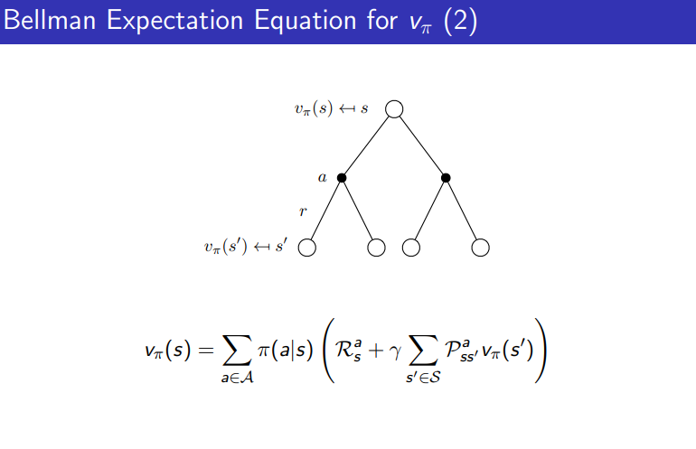

Slide 12
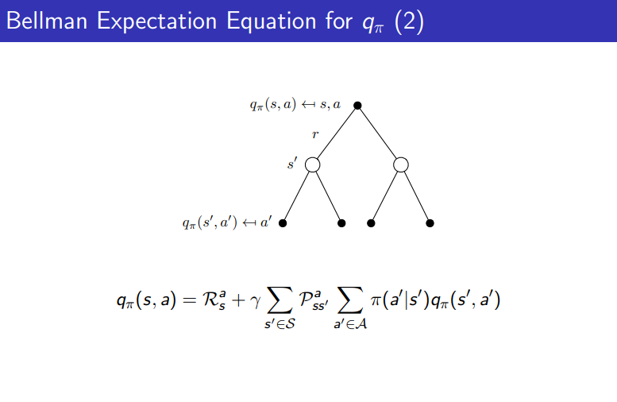

Slide 13
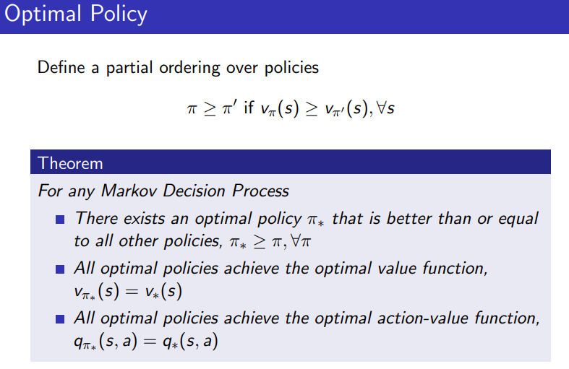

Slide 14

Can we solve MDPs directly
Well, it’s possible. The Bellman Optimality equation can be solved directly by,
However, as we know, Matrix inversion is a costly process, requiring O(n³).
Notes:
There are methods with O(n²), but even then, it is difficult to invert.
This is similar to Newton’s method for solving Linear Regression problems, but we prefer iterative methods.

Slide 15
Dynamic Programming to Solve MDPs
It is a method for solving problems by breaking them down into subproblems, each of which can be solved using caching and reusing.
Used for Planning in an MDP
Assumes Full knowledge of MDPs
Two Primary Methods: Policy Iteration and Value Iteration

Slide 16
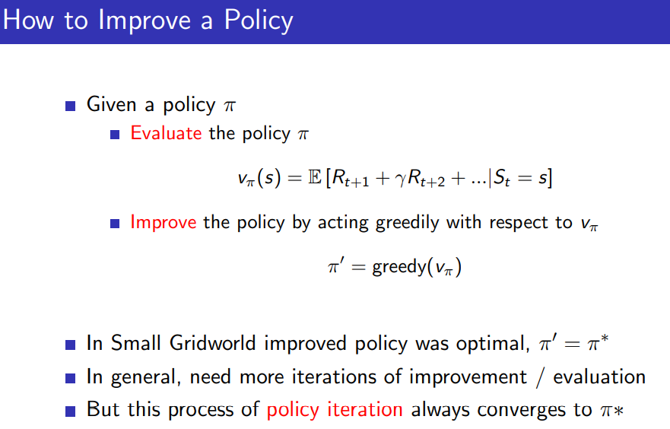
Policy Iteration

Slide 17
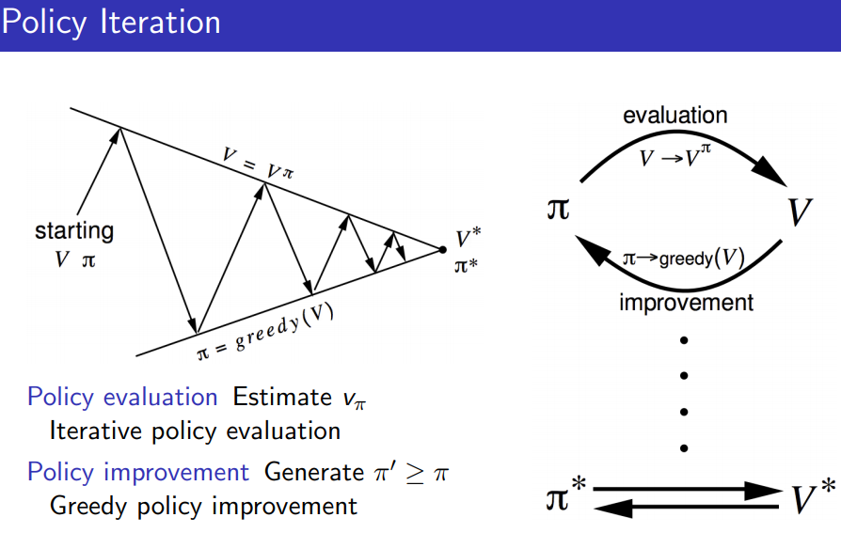

Slide 18
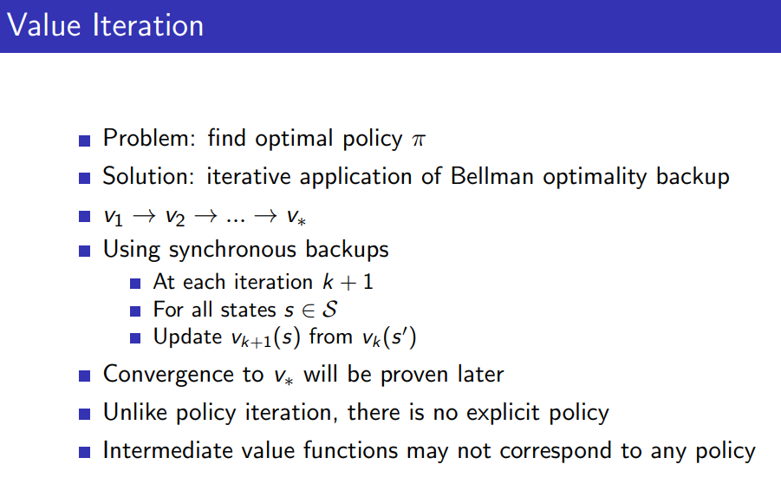

Slide 19
Model-Free Methods
Till now, we have been studying model based methods
Now, we will look at Model-Free Methods. Eg: Monte-Carlo(MC) and Temporal Difference(TD)
Notes:
In model-based methods, we know the exact state transition probabilities, which is unrealistic.

Slide 20
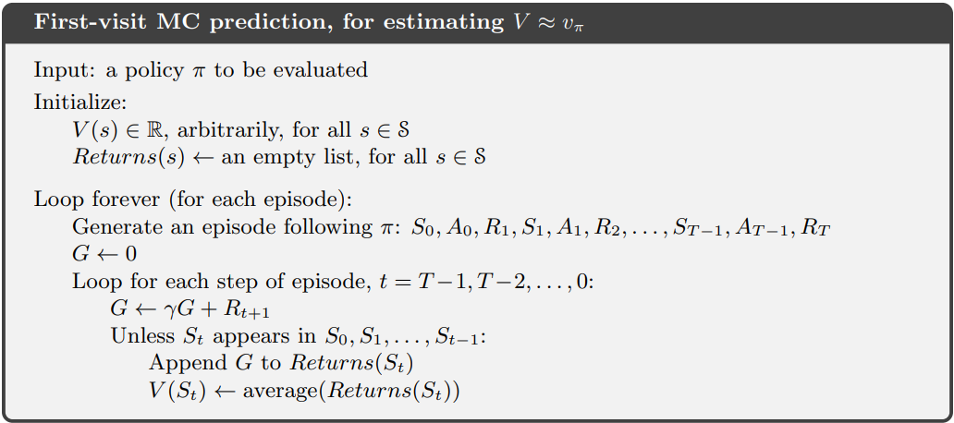

Slide 21
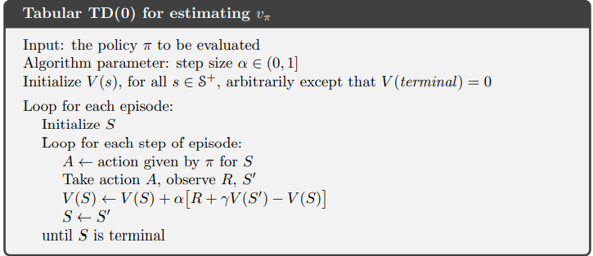
n-Step TD is basically the update equation modified over n steps.
Notes:
TD methods learn directly from episodes of experience
TD is model-free: no knowledge of MDP transitions / rewards
TD learns from incomplete episodes, by bootstrapping
TD updates a guess towards a guess
Advantages of TD over MC
TD can learn before knowing the final outcome
TD can learn online after every step MC must wait until end of episode before return is known
TD can learn without the final outcome
TD can learn from incomplete sequences MC can only learn from complete sequences
TD works in continuing (non-terminating) environments
MC only works for episodic (terminating) environments
Also, MC has high variance, zero bias(theoretically)
TD has low variance, some bias(sensitive to initial values)
In practice, TD learns faster
TD exploits Markov Property so useful in Markov envs
MC does not, so useful in non-Markov

Slide 22
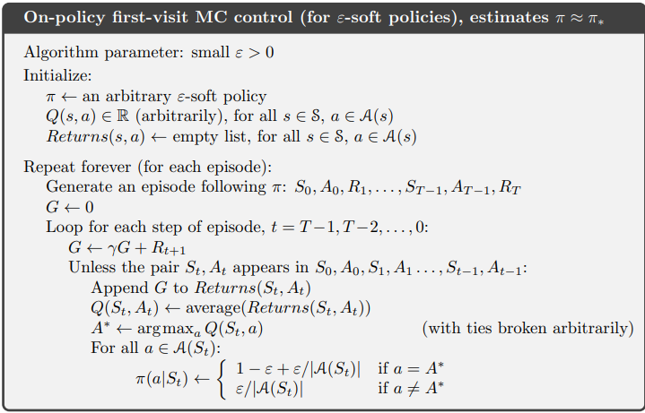
Notes:
What is on-policy vs off-policy?
On-policy learning
“Learn on the job”
Learn about policy π from experience sampled from π
Off-policy learning
“Look over someone’s shoulder”
Learn about policy π from experience sampled from µ

Slide 23
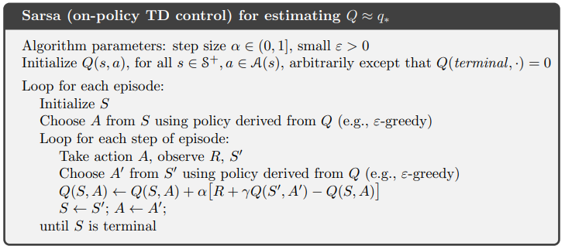

Slide 24
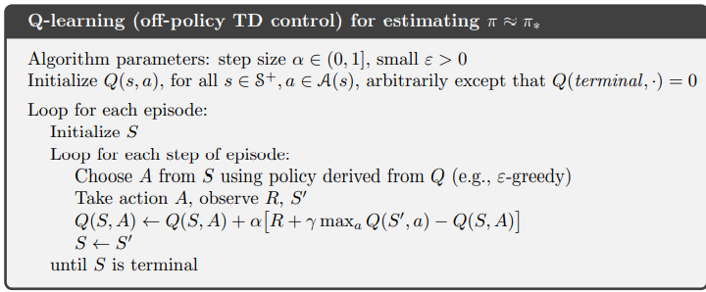

Slide 25

Expected SARSA
Basically Q-Learning, but with one change

Slide 26
Function Approximation
Same methods, but we cannot fill a table as we have been doing so far, as we have to fill a table of size SxA, which blows up quickly.
Therefore we approximate all the terms defined above.
The states have to be broken down into features, like coordinates, to then be fed into a function approximator like most of our traditional Supervised learning methods.
Notes:
We used to query the value function in the table. Now, as the table grows, we are forced to use Function Approximators.
Can someone mention a theoretical disadvantage of using the Supervised Learning methods?
The inputs are not i.i.d. I.e. Independent and Identically Distributed, which is normally an underlying assumption in supervised.

Slide 27
Policy Gradient Methods
Will not be covered due to paucity of time
In brief, the policy is updated directly
Actor Critic uses both of the previous methods

Slide 28
Thank You
Special thanks to Somnath, Yash and Tharun for helping out with the ppt and prequels.

